Slide 1


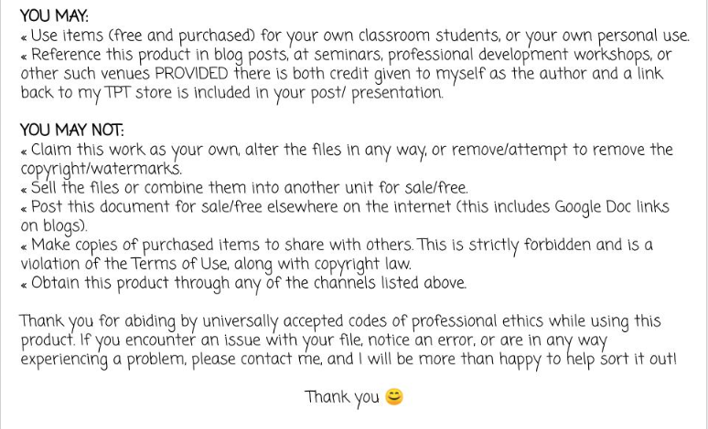

North Georgia Literacy Associates
Thank You for your purchase!

Slide 2

How to use this resource:
Print a copy of slide 5 (the Identity Shoe) for each student).
Guide the class through a discussion of the meaning of Identity using slide 2.
Allow the students a few minutes to complete the graphic organizer on slide 3.
Review the items on the checklist the students need to include on their Identity Shoe. Once they add each category to their show, they can move the corresponding X to the box.
Students may write or draw their category answers on their shoes.
Finally, students may finish coloring their shoe to fully reflect their personality.

Slide 3
There are many parts to a person’s unique identity
Athlete
Smart
Artistic
Religious
A Person
Daughter
Funny
Sister
Student

Slide 4
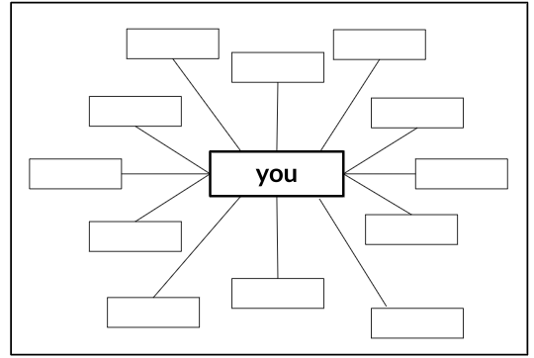
What are important parts of your identity?
Spend a few minutes in reflection. Then, fill in the boxes with words that describe you.

Slide 5
Identity Shoe Checklist
Completed | Title | Description
 | Name | Given name, nickname, reason parents gave you that name
 | Relationships | List all of the different relationship roles that you have such as, brother, son, granddaughter, niece…
 | Cultural | List cultural aspects of your life like religion, faith, ethnicity, language, nationality, etc.
 | Likes | List your favorite activities, hobbies, movies, sports, TV shows, singers, etc.
 | Dislikes | List the activities, hobbies, movies, sports, TV shows, singers, etc. that you do not care for.
 | Hopes | List things that you want to do in the future; jobs, going skydiving, getting married, traveling, etc.
Notes:
Once each category has been added to the student’s shoe, they will move the corresponding X to the completed box.

Slide 6
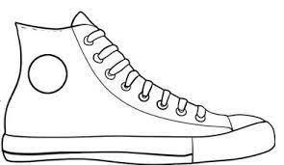
My Identity Shoe

